Slide 1
Web Engineering
Zaheer Ahmed

Slide 2
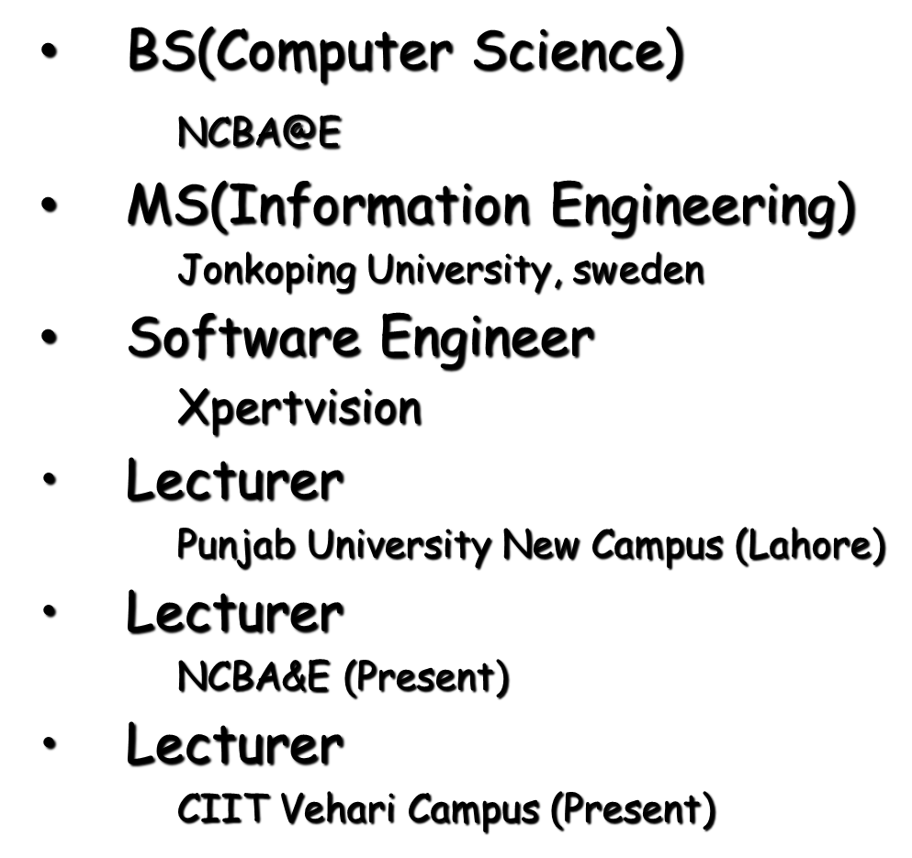
Introduction

Slide 3
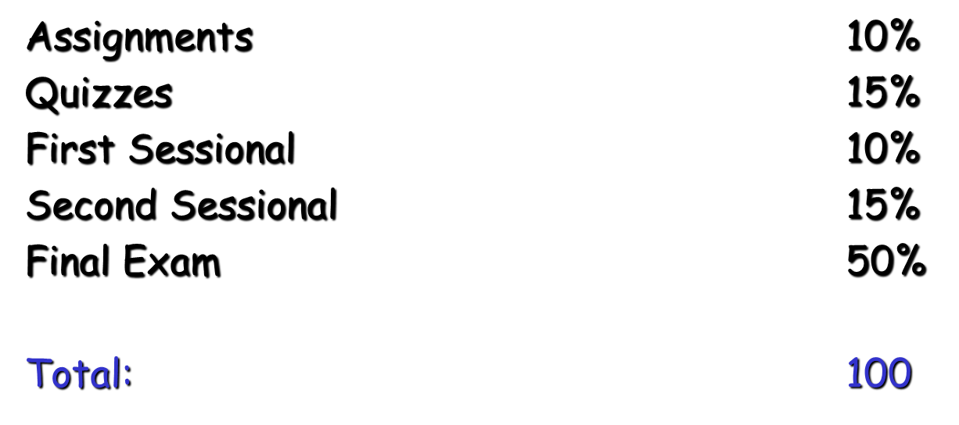
Course Grading

Slide 4
Course Books
Recommended Books:
Web Engineering: The discipline of Systematic development of web applications Edited by: Gerti Kappel, Birgit Proll, Siegfried Reich, Werner Retschitzegger
Web enabled Commercial Application Development using HTML, DHTML, JavaScript, Perl, CGI by Ivan Bayross.
Reference Books:
1) Web Engineering by Pankaj Sharma

Slide 5
Course Outline
An Introduction to web engineering
Protocols for Web applications: HTTP Role in Web Development
Overview of three tire Architecture
HTML (Basic)
HTML(Advance)
CSS (Cascading Style Sheets)
HTML Forms and Input
Java Script Basics, functions
PhP Basics (Syntax, Variables, Loops)
PHP Forms and User Input
PHP MySQL Introduction
PHP + MySQL
Structured Query Language
Connection With data base
Project Final Viva

Slide 6
Course Policy
Class participation and regular attendance is expected. Students are responsible for bringing themselves up-to-date on class material and assignments. Exams will be a combination of material presented in lectures, and homework problems. Homework should be completed and returned in the specified time for marking.

Slide 7
Objective
This course is aimed at to make students learn about how to engineer a web based project as well as latest tools, technologies and developments in the respective field.
This course introduces basic Web page development techniques. Topics include HTML, scripting languages, and commercial software packages used in the development of Web pages. At the conclusion of this course, students will be able to use specified markup languages to develop basic Web pages.
Unless otherwise indicated, evaluation of student’s attainment of objectives is based on knowledge gained from this course. During performance evaluations, students will be provided necessary tools, equipment, materials, specifications, and any other resources necessary to accomplish the task. Specifications may be in the form of, but not limited to, manufacturer’s specifications, technical orders, regulations, national and state codes, certification agencies, locally developed lab assignments, or any combination of specifications

Slide 8
Lesson Plane
Lesson | Week Days
Lecture1+ project Lecture 2 | Thursday Thursday

Slide 9
Lab Task
Macromedia dreamweaver
My SQL (XamPP)
FileZilla
WordPress

Slide 10
Assignment Tasks
Web Development Project (Project Marks include in the lab Marks)

Slide 11
Introduction
Let’s go back in time and revisit the early decades of computer software development. During the 1950s and 1960s few people appreciated the importance of computer-based systems, and virtually no one foresaw the global impact that computer hardware and software would have on every aspect of society in the late twentieth and early twenty first centuries. Most people who worked with computers during the early days stumbled into the business, creating computer programs using a combination of informality, urgency, intuition, and art. When things worked out well, this approach lead to important advances in computing. But things didn’t always work out well. Computer-based systems often failed to do what they were supposed to do; were delivered late or not at all; and were difficult and sometimes impossible to correct, adapt, and enhance in any reasonable time frame. The old-school approach was, regrettably, a hit-or-miss proposition.

Slide 12
Introduction
•“The application of systematic and quantifiable approaches to cost effective analysis, design, implementation, testing, operation, and
maintenance of high-quality Web applications.” –
Kappel et al.
• Extends Software Engineering to Web applications, but with Web-centric approaches. And other relevant contributions from many disciplines

Slide 13
Defining Web Applications
Unlike traditional software, the Web serves as both development & user platform.
• A Web application is a system that utilizes W3C standards & technologies to deliver Web-specific resources to clients (typically) through a browser. Kind of …Technology + interaction.
– Web site with no software components?
– Web services?

